Slide 1

SAR Earth Explorer Advanced: Unveiling Earth Processes
A project developed for the NASA Space Apps Challenge 2023, leveraging Synthetic Aperture Radar (SAR) data for comprehensive monitoring of natural disasters and environmental changes, providing critical insights into Earth's dynamic processes.
Team 0Day
Team Lead: Jayanth Adhithyaa G R - jayanthadhithyaagr@gmail.com
Member 1: Deepak K M - kmariandeepak@gmail.com
Member 2: Yasvanth Kanna A - yasvanthkanna0202@gmail.com
Member 3: Amritha N - amritha.n_25cs@kgkite.ac.in

Slide 2

SAR Earth Explorer Advanced
What it Does
Real-time Flood Monitoring: Detects flood extent and depth using SAR imagery.
Landslide Risk Assessment: Identifies vulnerable areas based on subtle ground deformation.
Interactive Data Visualization: Provides user-friendly maps, 3D models, and time-series analysis.
AI-Powered Analysis: Automates pattern recognition, anomaly detection, and predictive modeling.

Slide 3

SAR Earth Explorer Advanced: How It Works
Data Processing Pipeline
Multi-temporal Analysis
Efficiently manages SAR data from acquisition to analysis.
Compares SAR images over time to detect subtle surface changes.
Polarization Analysis
3D Visualization
Exploits SAR polarizations to characterize surface features.
Renders complex SAR data into intuitive 3D models.
Risk Scoring
Assigns quantitative risk scores to identified hazards.

Slide 4





SAR Earth Explorer Advanced: Technology Stack
Frontend Development
Built with React 18, React Router DOM, Vite, and modern CSS3 for dynamic user interfaces.
Data Visualization & Geospatial
Uses Recharts, D3.js, Three.js for 3D, and Leaflet for interactive maps.
AI & Machine Learning
Leverages TensorFlow.js for on-the-fly machine learning and real-time environmental insights.
Development & Build Tools
Powered by Node.js and npm, with Git for collaborative version control.

Slide 5



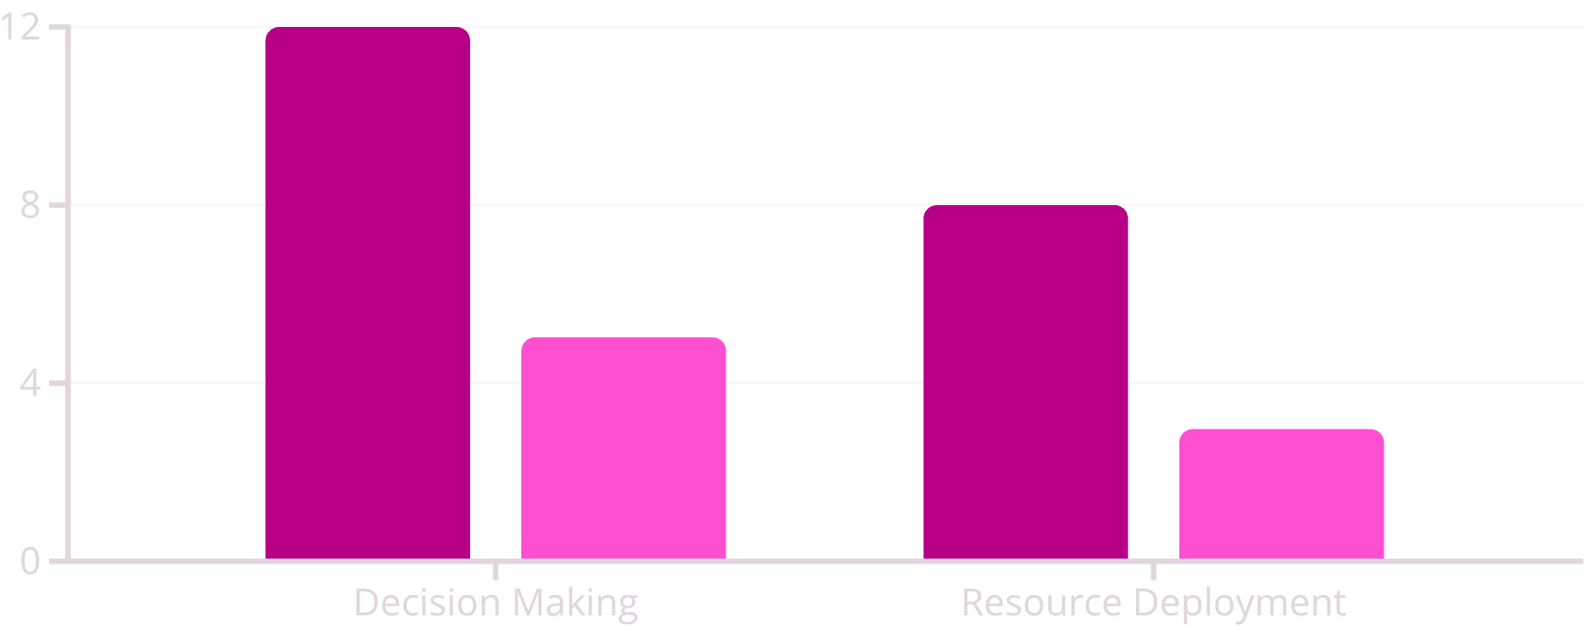
SAR Earth Explorer Advanced: Key Benefits & Impact
Disaster Management
Environmental Monitoring
Scientific Research
Provides near real-time insights for rapid flood monitoring and landslide risk assessment, crucial for effective emergency response and preventative measures.
Enables comprehensive observation of land, water, and ice changes, from deforestation tracking to monitoring glacial melt, supporting sustainable management and climate research.
Leverages AI-powered insights to facilitate new discoveries and develop predictive models for geophysical phenomena, hydrological cycles, and ecological dynamics.
Flood Response Efficiency (...
Landslide Early Warning (da...
The chart illustrates the impact of SAR Earth Explorer Advanced: Flood Response Efficiency reduces decision-making time by 12 hours and resource deployment by 8 hours. Landslide Early Warning provides 5 days lead time for decision-making and 3 days for resource deployment.

Slide 6




Innovation & NASA Alignment
SAR Earth Explorer Advanced innovates with browser-based SAR processing, 3D visualization, and gamified learning. It aligns with NASA Space Apps goals by empowering global communities with accessible Earth observation.
Creative & Innovative Aspects
Important Considerations
NASA Space Apps Alignment
Optimized for performance, accessibility, and data accuracy.
Addresses challenge goals via open-source tools, community engagement, and universally accessible SAR data.
Key features: browser-based SAR processing, interactive 3D visualization, and gamification.

